Slide 1
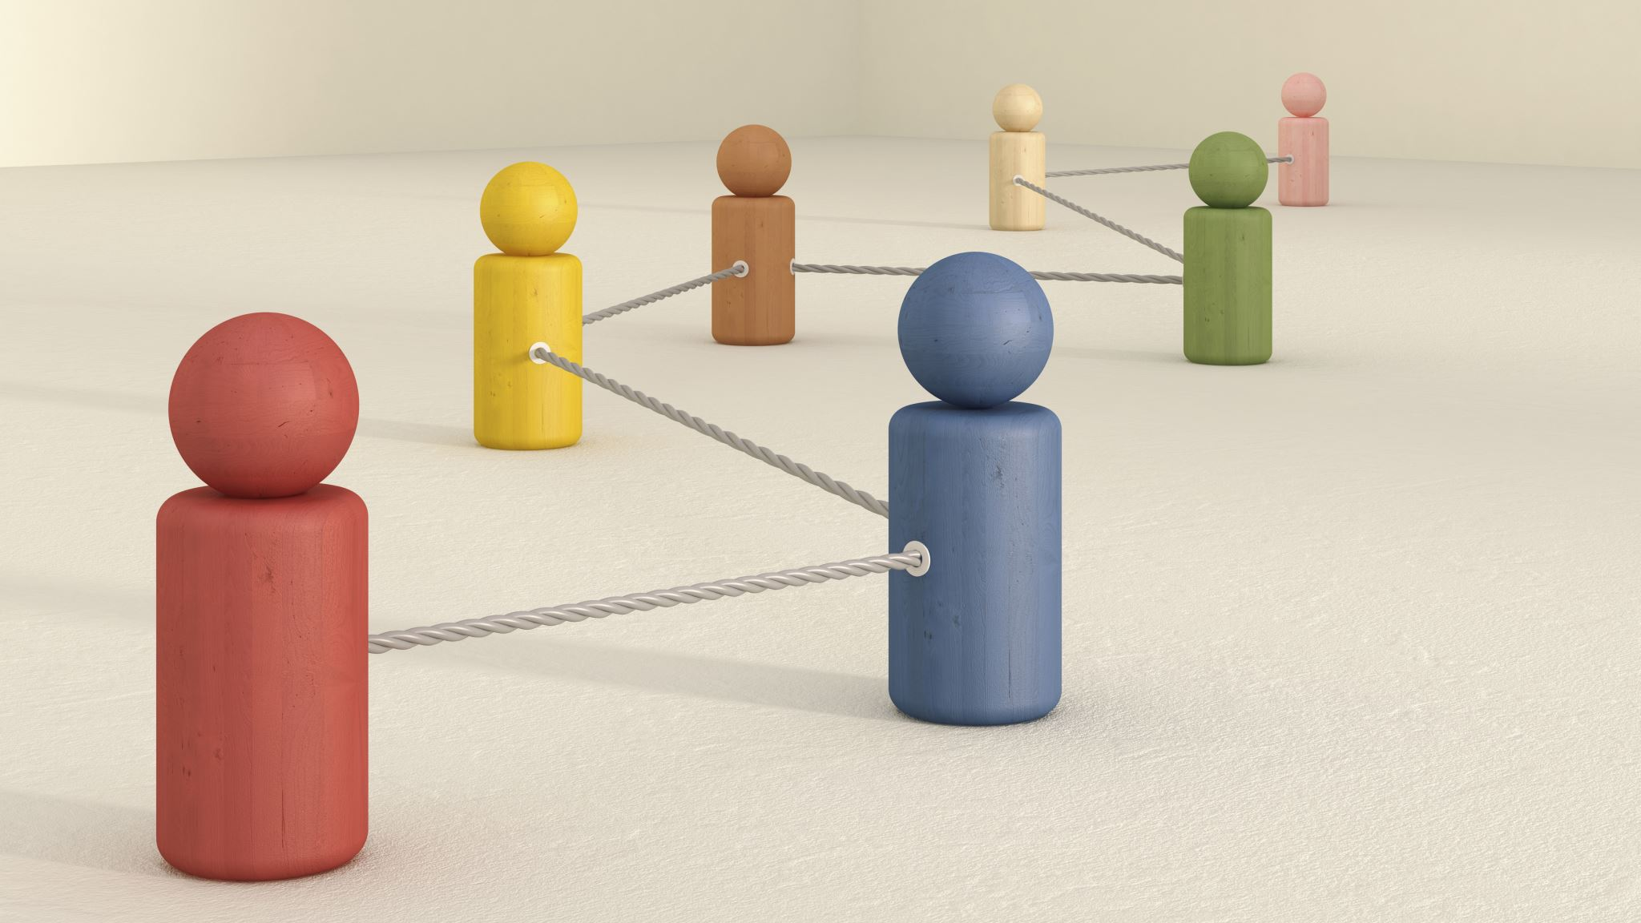
Customer Segmentation
Xiuhao Shuai
ADMN5016

Slide 2
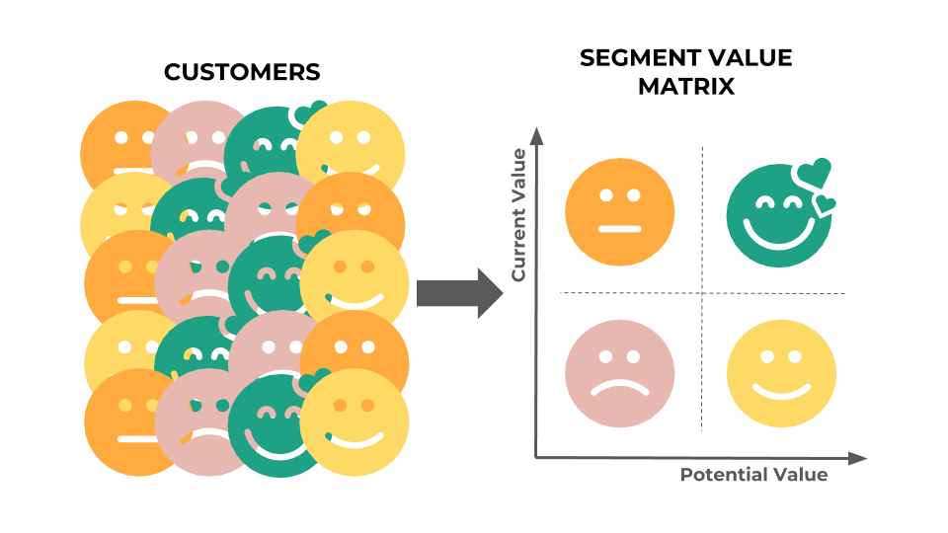
About the Model
An automobile company has plans to enter new markets with their existing products
In the existing market, the sales team has classified all customers into 4 segments (A, B, C, D ). Then, they performed segmented outreach and communication for each different segment of customers.
They plan to use the same strategy for the new markets and have identified 2627 new potential customers.
Help the manager to predict the right group of the new customers.
Dataset from Kaggle:
https://www.kaggle.com/datasets/kaushiksuresh147/customer-segmentation?datasetId=841888

Slide 3
About the Model
Historical Customer Records
A
B
C
D
New Customer Records
A
B
C
D

Slide 4
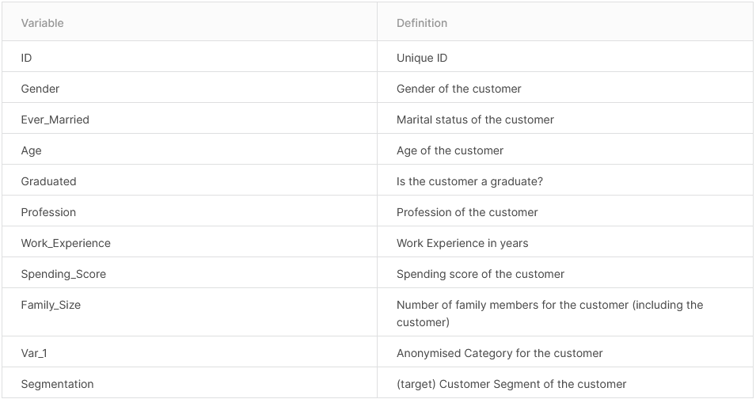
Content

Slide 5
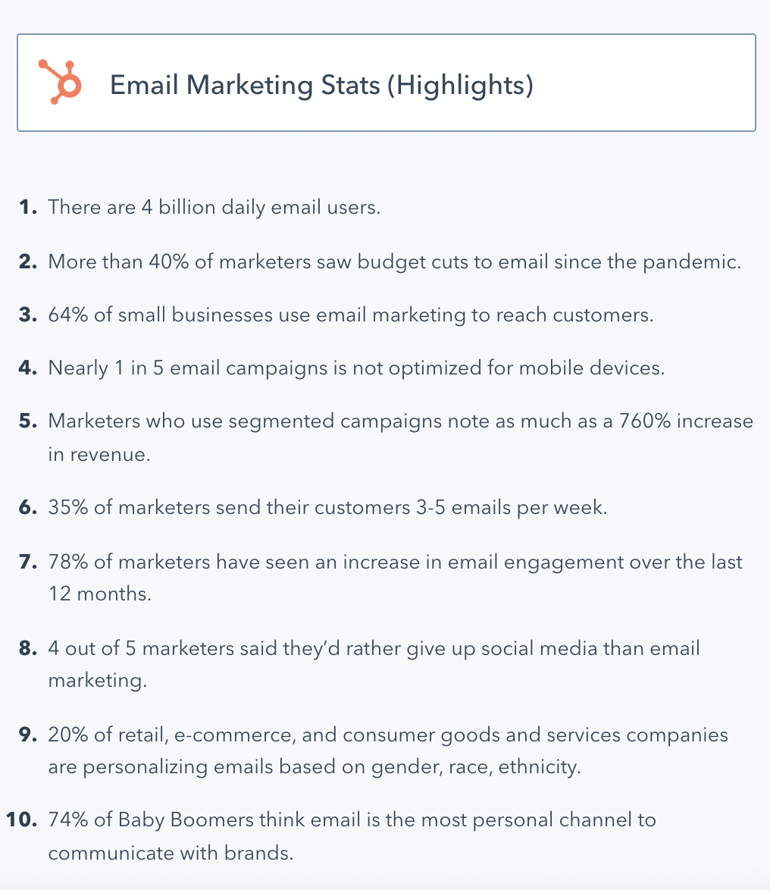
Email Marketing Statistics for 2022
Source: Hubspot

Slide 6
Values
New Market: 2627
Value of unit marketing:
$10
Accuracy: 0.3129
Total correct prediction value: accuracy*marketing unit
0.3129*2627*10 = $8220

Slide 7
Benefits
Fast Result
Marketing boost

Slide 8
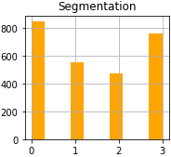
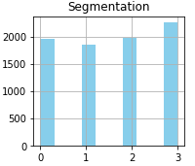
Conclusion
The distribution of segmentations for new customers, was not as equally distributed as the historical customer records.
New customers might have undiscovered marketing characteristics.
New Data
Historical Data

Slide 9
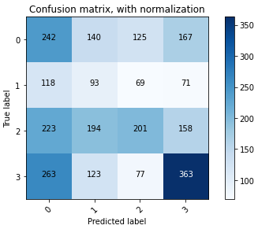
Conclusion
The Model is better at predicting segmentation D.
The recall & precision is worse in predicting seg A,B,C

Slide 10

Conclusion
Accuracy rate is low, data not showing clear clustering
-> New marketing segmentations should be developed for fitting the new customer groups.
-> More dimensions are needed
Try different models
-> Neural Networks -> probability of being in (A/B/C/D) -> choose the one with greatest probability

Slide 11

Thank you

